Slide 1

Reducing violent crime in Denver
Rapid reporting to reduce assaults and escalation.

Slide 2
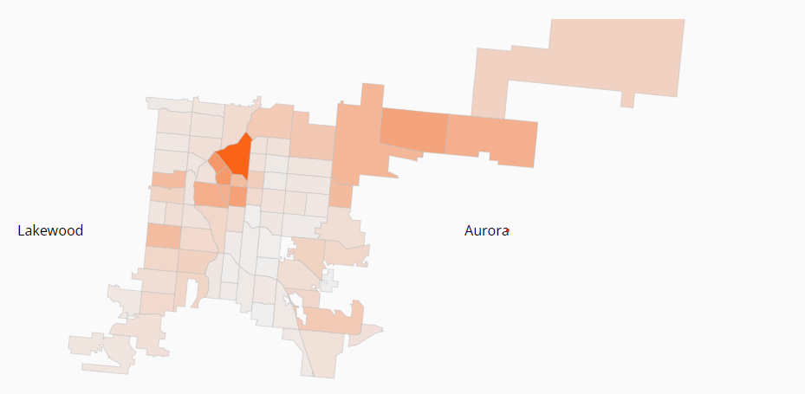
DENVER CRIME OVERVIEW
Summary
Map of Assaults in 2021
5.3 violent crimes per 1,000 residents so far this year.
Reported violent crime is up 7.4% (3675 so far in 2021, 3423 until this date in 2020)
Serious assaults are up 10.9% (2288, 2064)
Source Denver Post, Crime of Denver Report, 9/29/2021

Slide 3

ASSAULT
Assault is the most common violent crime and often a pre-cursor to even more serious crimes such as rape and homicide.
Prompt reporting means a prompt response with less chance of escalation and greater chance of apprehension
A “Broken Bones” theory of criminology.

Slide 4
DATA SET
2017 – Present – Denver provides easily accessed data on all crime, updated regularly. https://www.denvergov.org/opendata/
Special Thanks to Paul Mooney for providing regularly updated versions of the data to Kaggle. https://www.kaggle.com/paultimothymooney/denver-crime-data
Data set covers 19 columns for 522k Records

Slide 5
FEATURE ENGINEERING
All experiments perform in Python using NumPy and Pandas.
Data reduced to exclusively look at those codes related to the crime of assault
Occurrence Time and Reporting Time converted to TimeSeries and used to create new Reporting Delay field as TimeDelta.
Reporting Delay then converted to minutes as a float for easier use.
Month, hour, and day of the week for each occurrence extracted into separate columns as int64.

Slide 6
EXPERIMENTS Performed
All tests performed using One-Way ANOVA with the Statsmodels package.
P-value of .05 considered as cut off for rejecting the null hypothesis and determining statistical significance.
Differences in mean of reporting delay tested:
By Precinct (pvalue = 4.182e-12)
By Month(pvalue = .068)
By Time of Day (pvalue = 3.441e-12)
By Day of Week (pvalue = .027)
Null Hypothesis is confirmed by Month but rejected in all other cases.
Precinct and Time of Day have the most certain significance and will be the most strongly considered as basis for recommendations.

Slide 7
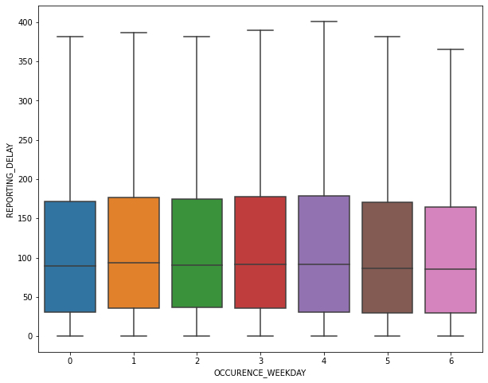
REPORTING DELAY BY WEEKDAY

Slide 8
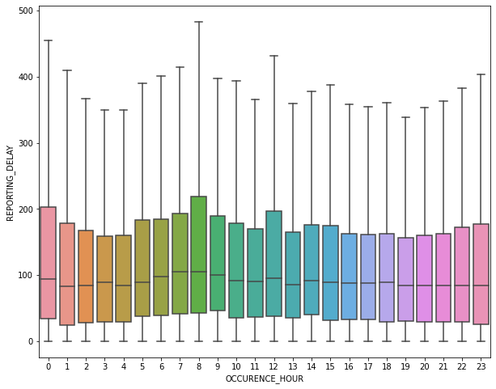
REPORTING DELAY BY HOUR

Slide 9
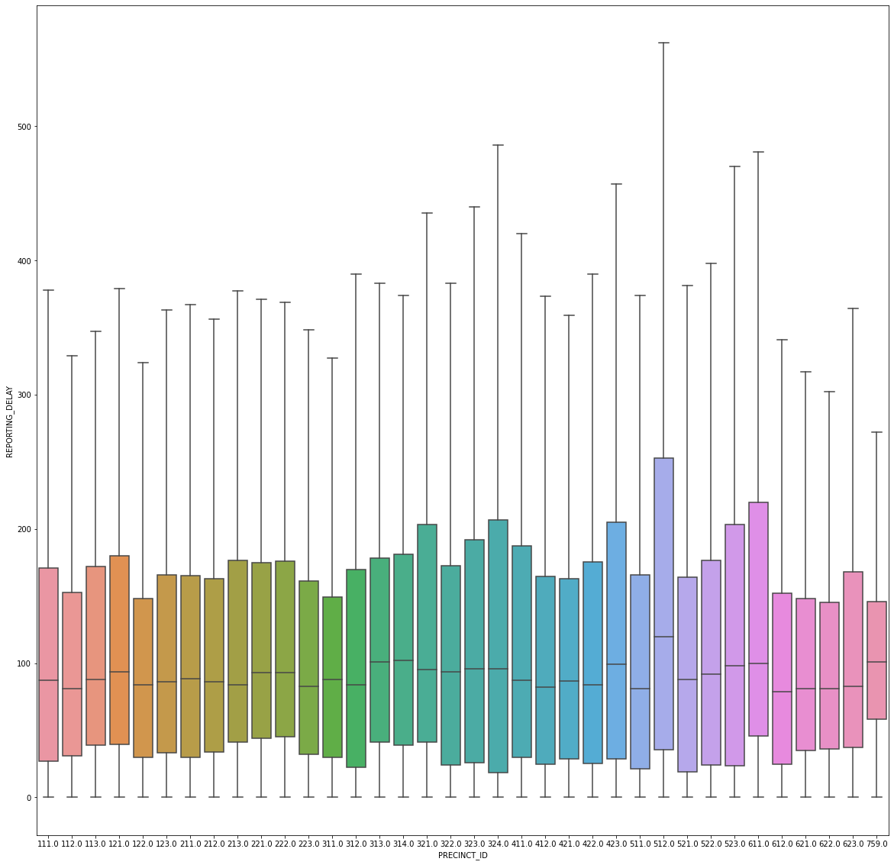
REPORTING DELAY BY PRECINT

Slide 10
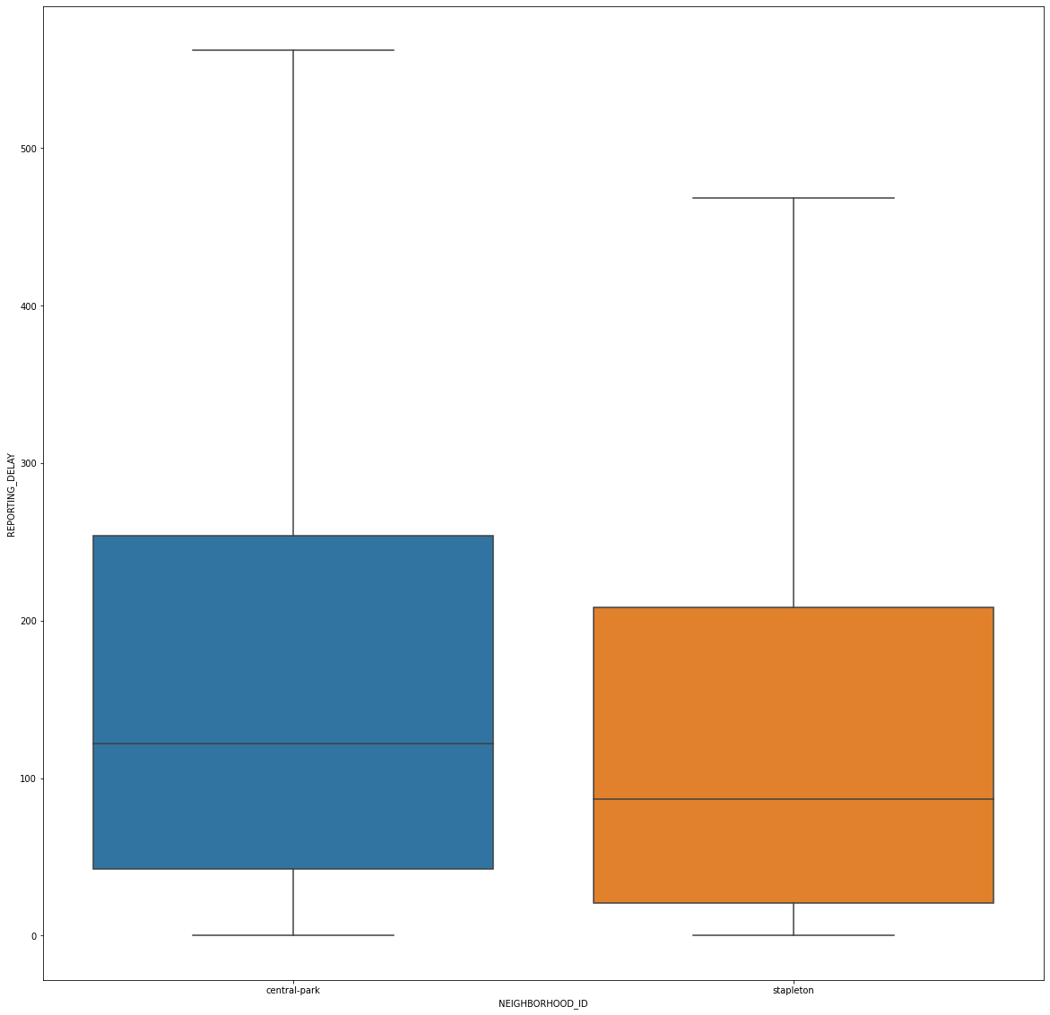
FOCUS on 512 – DELAY BY NEIGHBORHOOD

Slide 11
RECCOMENDATIONS
Patrolling Central Park
Reduce Time Spent on Minor Accidents
Why?: Slowest crime reports, high number of incidents.
Short Term: Increase car and foot patrol.
Long Term: Consider additional electronic surveillance and call boxes.
Why? : Morning commute represents single largest, sustained spike in reporting times for violent crime.
Definition: Accidents where no party needs to be transported by ambulance and no car must be towed from the scene.
Short Term:
Review for these incidents are prioritized.
Train emergency operators to instruct those reporting accidents, to photograph the scene and clear the roadway.
Long Term:
Develop an app that allows those involved to document the accident and share insurance information.

